Slide 1
Lecture 7
Aggregate functions.
Window functions.

Slide 2
Aggregate functions. Window functions.
PART I. Aggregate functions.
PART II. Window functions.

Slide 3
PART I. Aggregate functions.

Slide 4
Introduction to PostgreSQL aggregate functions
Aggregate functions perform a calculation on a set of rows and return a single row. PostgreSQL provides all standard SQL’s aggregate functions as follows:
AVG() – return the average value.
COUNT() – return the number of values. MAX() – return the maximum value.
MIN() – return the minimum value.
SUM() – return the sum of all or distinct values.
We often use the aggregate functions with the GROUP BY clause in the SELECT statement. In these cases, the GROUP BY clause divides the result set into groups of rows and the aggregate functions perform a calculation on each group e.g., maximum, minimum, average, etc.
You can use aggregate functions as expressions only in the following clauses: SELECT clause.
HAVING clause.

Slide 5
PostgreSQL AVG Function
The AVG() function is one of the most commonly used aggregate functions in PostgreSQL. The AVG() function allows you to calculate the average value of a set.
The syntax of the AVG() function is as follows: AVG(column)
You can use the AVG() function in the SELECT and HAVING clauses.

Slide 6
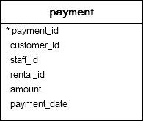
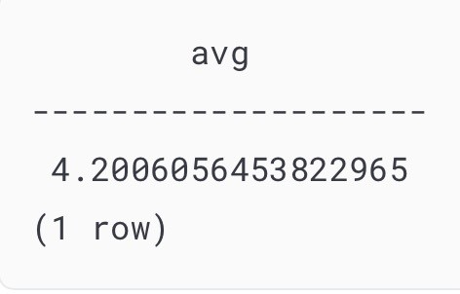
Example
SELECT AVG(amount) FROM payment;

Slide 7
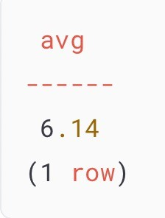
PostgreSQL AVG() function with DISTINCT operator
SELECT AVG(DISTINCT amount)::numeric(10,2) FROM payment;

Slide 8
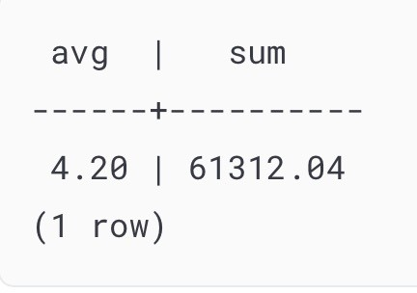
PostgreSQL AVG function with SUM function
SELECT
AVG(amount)::numeric(10,2), SUM(amount)::numeric(10,2)
FROM
payment;

Slide 9
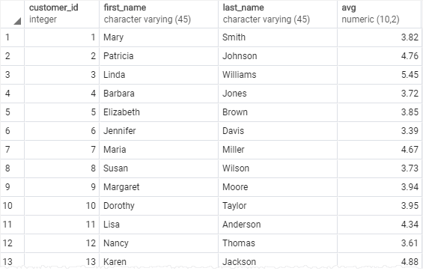
PostgreSQL AVG() function with GROUP BY clause
SELECT
customer_id,
first_name, last_name,
AVG (amount)::NUMERIC(10,2)
FROM
payment
INNER JOIN customer USING(customer_id) GROUP BY
customer_id ORDER BY
customer_id;

Slide 10
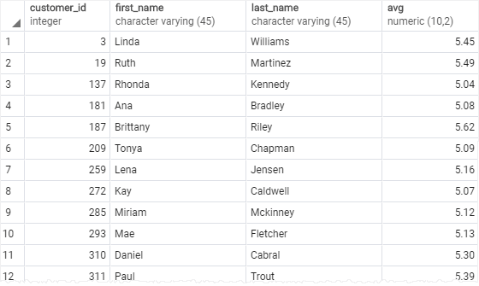
PostgreSQL AVG() function with HAVING clause
SELECT
customer_id, first_name, last_name,
AVG (amount)::NUMERIC(10,2)
FROM
payment
INNER JOIN customer USING(customer_id) GROUP BY
customer_id
HAVING
AVG (amount) > 5 ORDER BY
customer_id;

Slide 11
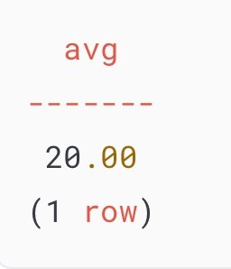
PostgreSQL AVG() function and NULL
CREATE TABLE t1 (
id serial PRIMARY KEY, amount INTEGER
);
SELECT AVG(amount)::numeric(10,2) FROM t1;
INSERT INTO t1 (amount) VALUES
(10),
(NULL),
(30);

Slide 12
PostgreSQL COUNT Function
The COUNT() function is an aggregate function that allows you to get the number of rows that match a specific condition of a query.
SELECT COUNT(column)
FROM table_name WHERE condition;

Slide 13
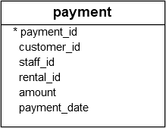

PostgreSQL COUNT() function examples
SELECT COUNT(*)
FROM
payment;

Slide 14
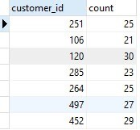
PostgreSQL COUNT() with GROUP BY clause
SELECT
customer_id,
COUNT (customer_id) FROM
payment GROUP BY
customer_id;

Slide 15

PostgreSQL COUNT() with HAVING clause
SELECT
customer_id,
COUNT (customer_id) FROM
payment GROUP BY
customer_id HAVING
COUNT (customer_id) > 40;

Slide 16
PostgreSQL SUM Function
The PostgreSQL SUM() is an aggregate function that returns the sum of values or distinct values.
The syntax of the SUM() function is as follows: SUM(DISTINCT expression)

Slide 17
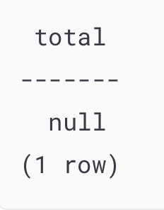
PostgreSQL SUM() function examples
SELECT SUM (amount) AS total FROM payment
WHERE customer_id = 2000;

Slide 18
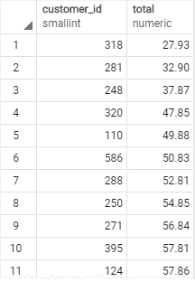
Using PostgreSQL SUM() function with GROUP BY clause
SELECT
customer_id,
SUM (amount) AS total FROM
payment GROUP BY
customer_id ORDER BY total;

Slide 19
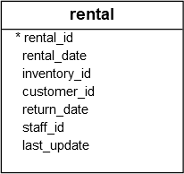
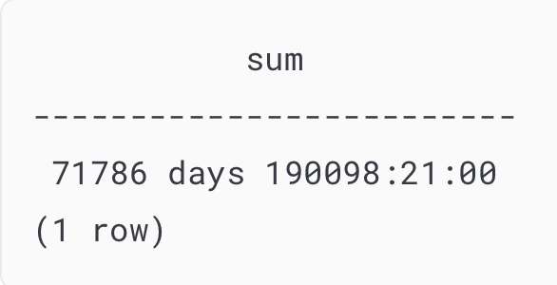
Using PostgreSQL SUM with expression
SELECT SUM(return_date - rental_date ) FROM rental;

Slide 20
PostgreSQL MAX Function
PostgreSQL MAX function is an aggregate function that returns the maximum value in a set of values.
The syntax of the MAX function is as follows: MAX(expression);
You can use the MAX function not only in the SELECT clause but also in the WHERE and HAVING clauses.

Slide 21

PostgreSQL MAX function examples
SELECT MAX(amount) FROM payment;

Slide 22
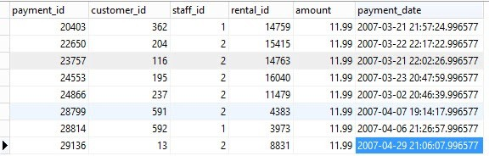
PostgreSQL MAX function in subquery
SELECT * FROM payment WHERE amount = (
SELECT MAX (amount) FROM payment
);

Slide 23
PostgreSQL MIN Function
PostgreSQL MIN() function an aggregate function that returns the minimum value in a set of values.
The syntax of the MIN() function is as follows:
SELECT
MIN(expression) FROM
table_expression
...;
Unlike the AVG(), COUNT() and SUM() functions, the DISTINCT option does not have any effects on the MIN() function.

Slide 24
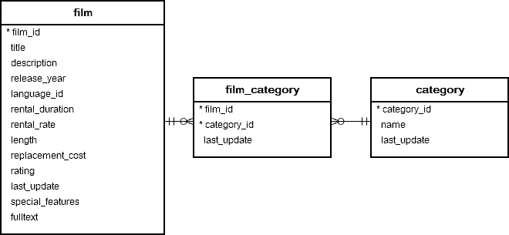

PostgreSQL MIN() function examples
SELECT
MIN (rental_rate) FROM
film;

Slide 25
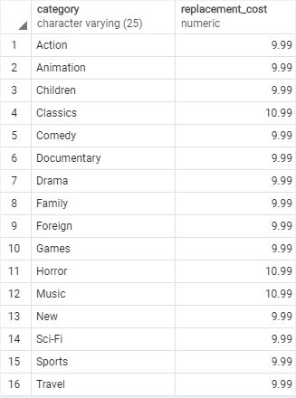
Using PostgreSQL MIN function with GROUP BY clause
SELECT
name category,
MIN(replacement_cost) replacement_cost FROM category
INNER JOIN film_category USING (category_id) INNER JOIN film USING (film_id)
GROUP BY name ORDER BY name;

Slide 26
PART II. Window functions.

Slide 27
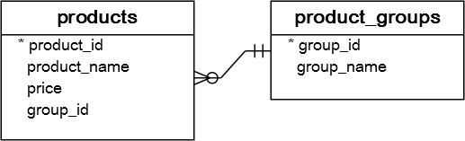
PostgreSQL Window Functions
CREATE TABLE product_groups ( group_id serial PRIMARY KEY,
group_name VARCHAR (255) NOT NULL
);
CREATE TABLE products (
product_id serial PRIMARY KEY,
product_name VARCHAR (255) NOT NULL, price DECIMAL (11, 2),
group_id INT NOT NULL,
FOREIGN KEY (group_id) REFERENCES product_groups (group_id)
);

Slide 28
PostgreSQL Window Functions
INSERT INTO product_groups (group_name) VALUES
('Smartphone'),
('Laptop'),
('Tablet');
INSERT INTO products (product_name, group_id,price) VALUES
('Microsoft Lumia', 1, 200),
('HTC One', 1, 400),
('Nexus', 1, 500),
('iPhone', 1, 900),
('HP Elite', 2, 1200),
('Lenovo Thinkpad', 2, 700),
('Sony VAIO', 2, 700),
('Dell Vostro', 2, 800),
('iPad', 3, 700),
('Kindle Fire', 3, 150),
('Samsung Galaxy Tab', 3, 200);

Slide 29

Introduction to PostgreSQL window functions
SELECT
group_name, AVG (price)
FROM
products
INNER JOIN product_groups USING (group_id) GROUP BY
group_name;

Slide 30
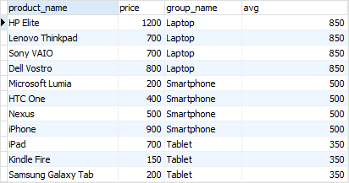
Example
SELECT
product_name, price, group_name,
AVG (price) OVER ( PARTITION BY group_name
)
FROM
products INNER JOIN
product_groups USING (group_id);

Slide 31
PostgreSQL Window Function
A window function performs a calculation across a set of table rows that are somehow related to the current row.
PostgreSQL Window Function Syntax:
window_function(arg1, arg2,..) OVER ( [PARTITION BY partition_expression]
[ORDER BY sort_expression [ASC | DESC] [NULLS {FIRST | LAST }])

Slide 32
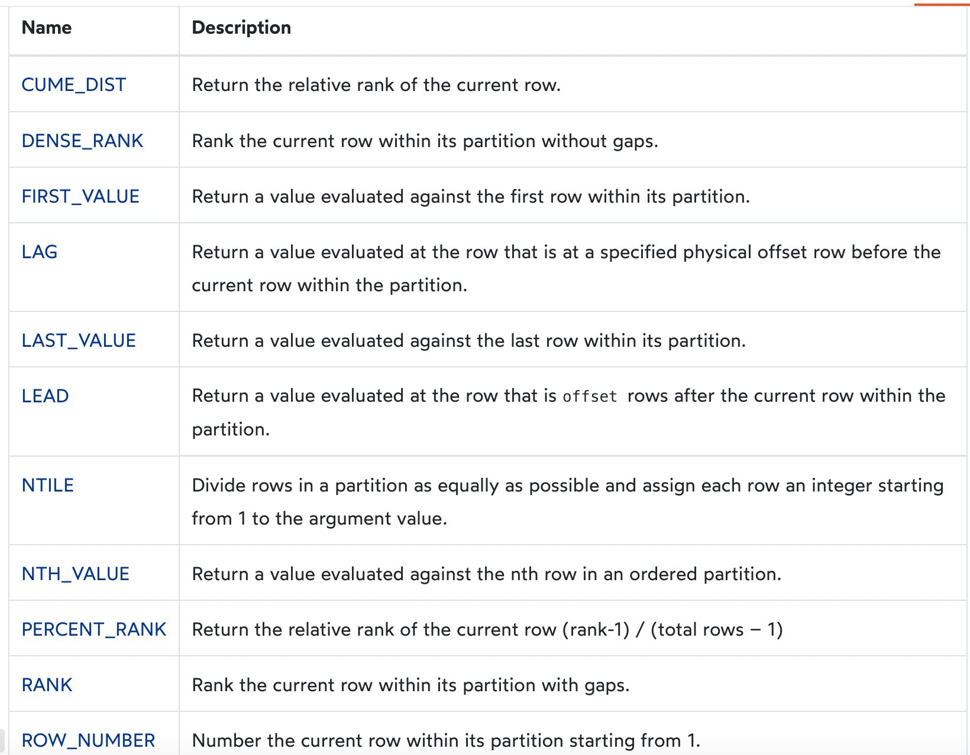
Window functions

Slide 33
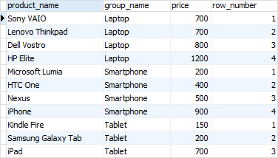
The ROW_NUMBER() function
The ROW_NUMBER() function assigns a sequential number to each row in each partition. See the following query:
SELECT
product_name, group_name, price,
ROW_NUMBER () OVER (
PARTITION BY group_name ORDER BY
price
)
FROM
products
INNER JOIN product_groups USING (group_id);

Slide 34
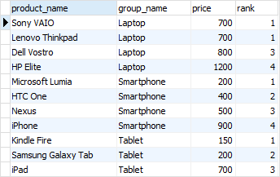
The Rank() function
The RANK() function assigns ranking within an ordered partition. If rows have the same values, the RANK() function assigns the same rank, with the next ranking(s) skipped.
SELECT
product_name, group_name,
price,
RANK () OVER (
PARTITION BY group_name ORDER BY
price
)
FROM
products
INNER JOIN product_groups USING (group_id);

Slide 35
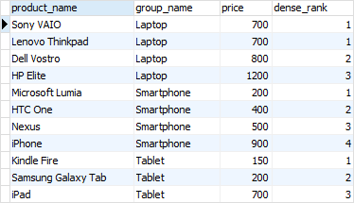
The Dense_rank() function
Similar to the RANK() function, the DENSE_RANK() function assigns a rank to each row within an ordered partition, but the ranks have no gap. In other words, the same ranks are assigned to multiple rows and no ranks are skipped.
SELECT
product_name, group_name, price,
DENSE_RANK () OVER (
PARTITION BY group_name ORDER BY
price
)
FROM
products
INNER JOIN product_groups USING (group_id);

Slide 36
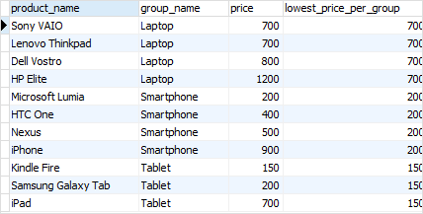
The FIRST_VALUE() function
The FIRST_VALUE() function returns a value evaluated against the first row within its partition.
SELECT
product_name, group_name, price,
FIRST_VALUE (price) OVER (
PARTITION BY group_name ORDER BY
price
) AS lowest_price_per_group
FROM
products
INNER JOIN product_groups USING (group_id);

Slide 37
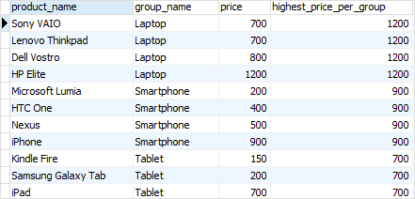
The LAST_VALUE() function
The LAST_VALUE() function returns a value evaluated against the last row in its partition.
SELECT
product_name, group_name, price,
LAST_VALUE (price) OVER (
PARTITION BY group_name ORDER BY
price
) AS highest_price_per_group
FROM
products
INNER JOIN product_groups USING (group_id);

Slide 38
The LAG and LEAD functions
The LAG() function has the ability to access data from the previous row, while the LEAD() function can access data from the next row.
Both LAG() and LEAD() functions have the same syntax as follows: LAG (expression [,offset] [,default]) over_clause;
LEAD (expression [,offset] [,default]) over_clause;
In this syntax:
expression – a column or expression to compute the returned value.
offset – the number of rows preceding ( LAG)/ following ( LEAD) the current row. It defaults to 1.
default – the default returned value if the offset goes beyond the scope of the window. The
default is NULL if you skip it.

Slide 39
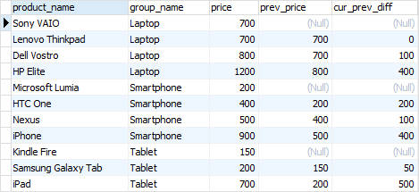
The LAG() function example
SELECT
product_name, group_name, price,
LAG (price, 1) OVER (
PARTITION BY group_name ORDER BY
price
) AS prev_price,
price - LAG (price, 1) OVER ( PARTITION BY group_name ORDER BY
price
) AS cur_prev_diff
FROM
products
INNER JOIN product_groups USING (group_id);

Slide 40
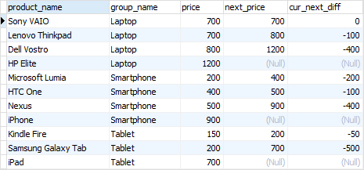
The LEAD() function example
SELECT
product_name, group_name, price,
LEAD (price, 1) OVER (
PARTITION BY group_name ORDER BY
price
) AS next_price,
price - LEAD (price, 1) OVER ( PARTITION BY group_name ORDER BY
price
) AS cur_next_diff
FROM
products
INNER JOIN product_groups USING (group_id);

